Slide 1
EDA & ML
Classification of HR Analytics using Machine Learning

Slide 2
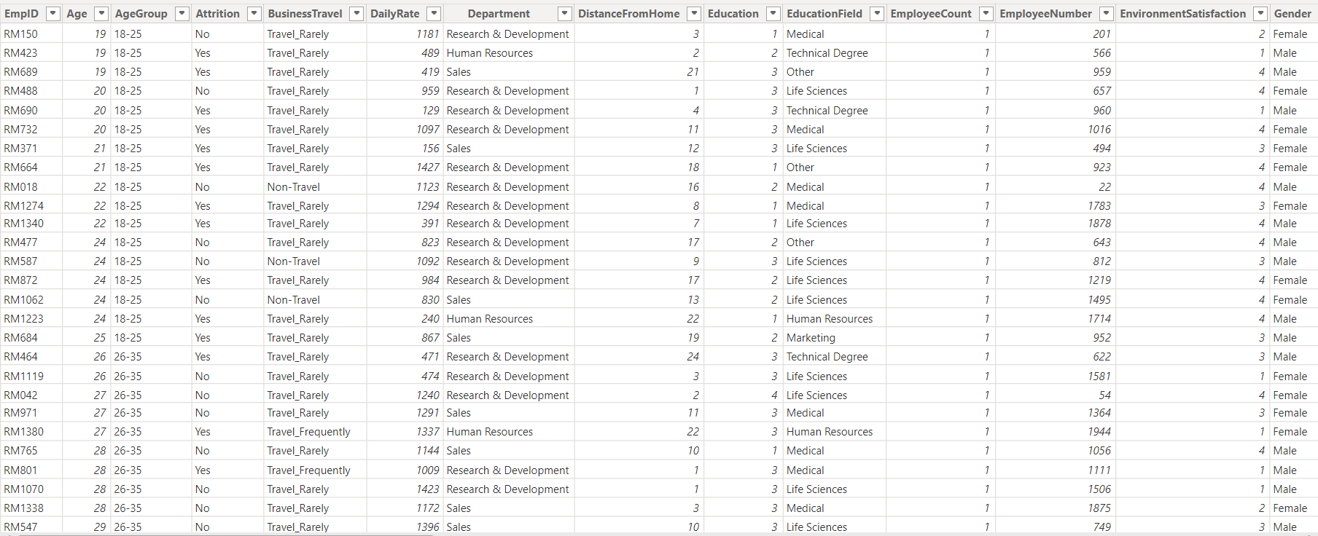
Description of Dataset
This dataset is having 1480 rows and 38 columns

Slide 3
Machine learning is a subset of artificial intelligence (AI) that allows systems to learn and improve from data without being explicitly programmed
Supervised Machine Learning
Supervised learning is defined as when a model gets trained on a “Labelled Dataset”. Labelled datasets have both input and output parameters. In Supervised Learning algorithms learn to map points between inputs and correct outputs. It has both training and validation datasets labelled.

Slide 4
Techniques used in this ML
Null values-
Data set was having 57 null values in YearsWithCurrManager column
Column is numerical, so by taking the average null values gets replaced by average value
df['YearsWithCurrManager'].fillna(np.mean(df['YearsWithCurrManager']), inplace = True)
Label Encoding-
Dataset was having 11 object columns so I transform them in numeric columns by Label Encoding
encode = LabelEncoder()df['EmpID'] encode.fit_transform(df['EmpID'])df['AgeGroup'] encode.fit_transform(df['AgeGroup'])

Slide 5
Algorithms
1. Decision Tree Classifier
2. Random Forest
3. SVC

Slide 6
